Slide 1
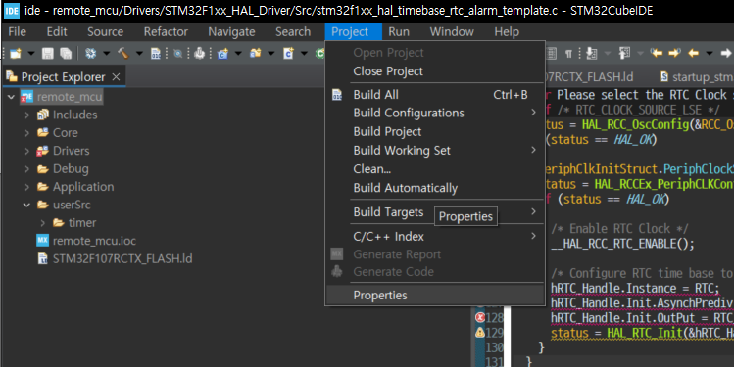
Optimization 설정

Slide 2
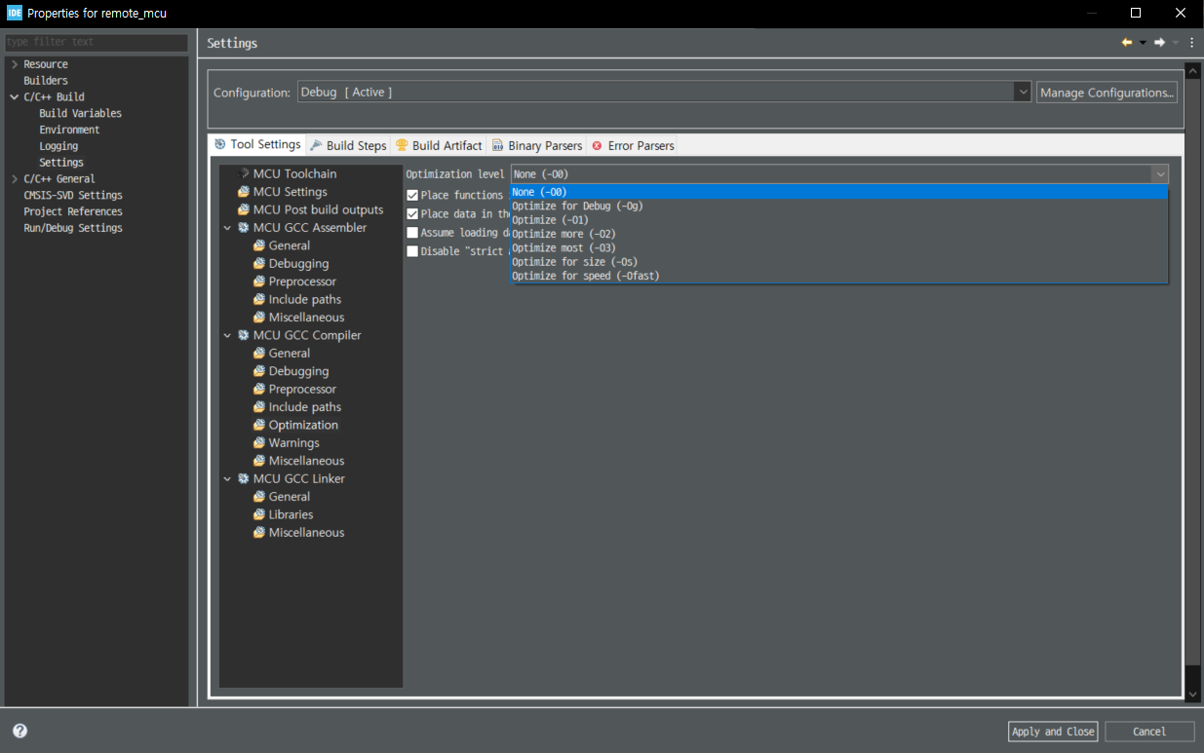
Optimization 설정
c/c++ build – settings –Tool settings

